Slide 1


Slide 2
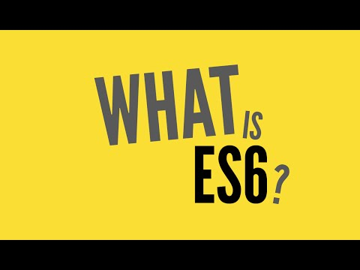

Slide 3
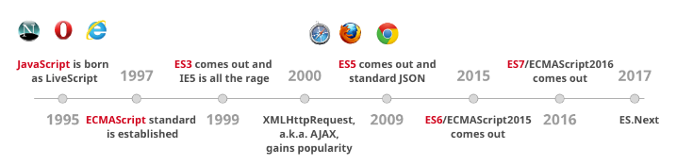

Slide 4
What is ES6
Ecma stands for (European Computers Manufacturers Association) Specification is called EcmaScript a scripting language which has Many Implementors.

Slide 5
What is ES6
Ecma stands for (European Computers Manufacturers Association) Specification is called EcmaScript a scripting language which has Many Implementors.
Javascript is Implementation of Ecma script

Slide 6
What is ES6
Ecma stands for (European Computers Manufacturers Association) Specification is called EcmaScript a scripting language which has Many Implementors.
Javascript is Implementation of Ecma script
Standard for all Browsers to Interpret Javascript

Slide 7
What is ES6
Ecma stands for (European Computers Manufacturers Association) Specification is called EcmaScript a scripting language which has Many Implementors.
Javascript is Implementation of Ecma script
Standard for all Browsers to Interpret Javascript
Latest version of EcmaScript Specification is ES6 also Called Harmony

Slide 8
Compatibility Table
Refer
https://kangax.github.io/compat-table/es6/

Slide 9
How to use Es6 Today
Although Today’s browser support 97% of features some are still pending
Use Babel Transpiler to transpile Es6 to Es5
https://babeljs.io
Webpack 2 for bundling and Transpiling
https://webpack.js.org/
https://blog.madewithenvy.com/getting-started-with-webpack-2-ed2b86c68783
Other notable transpilers Grunt/Traceur/Gulp

Slide 10
What is Covered under Ecma Script
Language Syntax - parsing, keywords, operators

Slide 11
What is Covered under Ecma Script
Language Syntax - parsing, keywords, operators
Types - undefined, null, boolean, number, string, and object

Slide 12
What is Covered under Ecma Script
Language Syntax - parsing, keywords, operators
Types - undefined, null, boolean, number, string, and object
Prototypes and inheritance

Slide 13
What is Covered under Ecma Script
Language Syntax - parsing, keywords, operators
Types - undefined, null, boolean, number, string, and object
Prototypes and inheritance
Built-in object and functions including Math, JSON, Array, object methods, etc

Slide 14
What is Covered under Ecma Script
Language Syntax - parsing, keywords, operators
Types - undefined, null, boolean, number, string, and object
Prototypes and inheritance
Built-in object and functions including Math, JSON, Array, object methods, etc
SpiderMonkey, Trident, and V8 also implement this specification. They are used in Firefox, IE and Chrome/Node.js/Opera respectively.

Slide 15
What are benefits of ES6
Most of ES6 new features provides syntactical sugar over ES5 and older versions
Makes Code cleaner
Improves Readability
Improves Coding Standards
Makes code better Maintainable,Re usable
Easy to learn and Implement
Can be used with any Modern JS Framework like ReactJS,Angular 4,Ember ,Vue, etc ...... (Never ending Frameworks)

Slide 16
ES6 Features
Classes
Modules
Arrow Functions
Block Scoping with Let,Const
Object and Array Destructuting
Rest and Spread Operators
Template Literals
Generators and Interators
Promises
Symbols
Collections - (Maps/Sets/Weak Maps)

Slide 17
ES6 Classes
ES6 classes are a simple sugar over the prototype-based OO pattern. Having a single convenient declarative form makes class patterns easier to use, and encourages interoperability. Classes support prototype-based inheritance, super calls, instance and static methods and constructors.

Slide 18
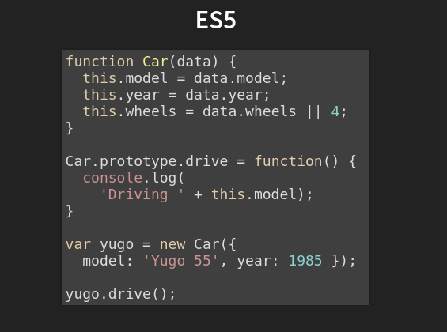
Class

Slide 19
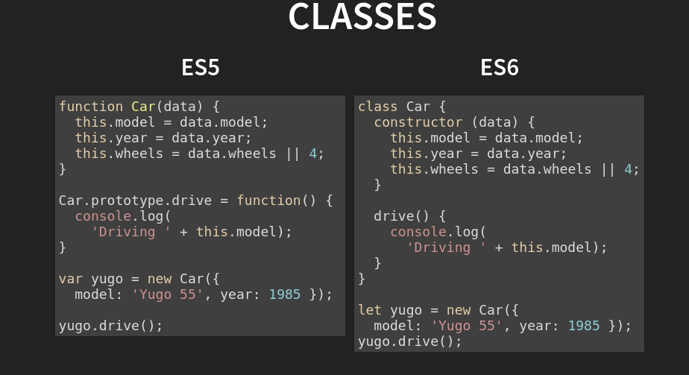

Slide 20
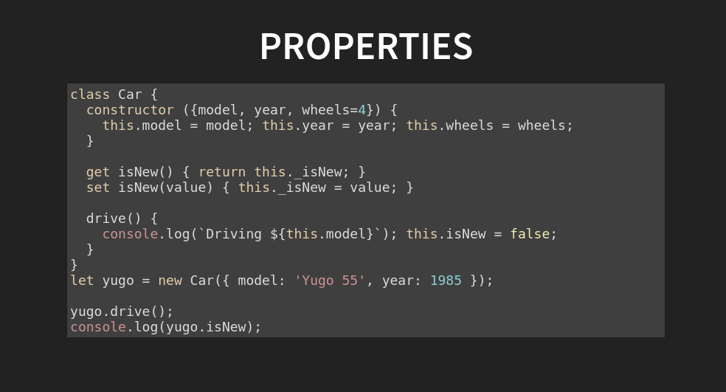

Slide 21
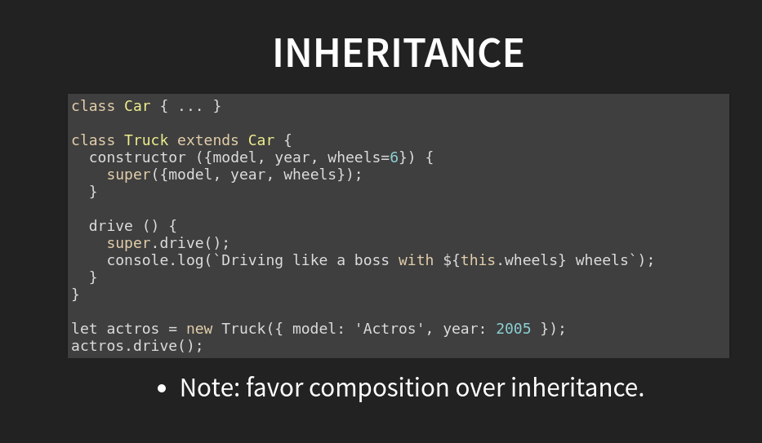

Slide 22
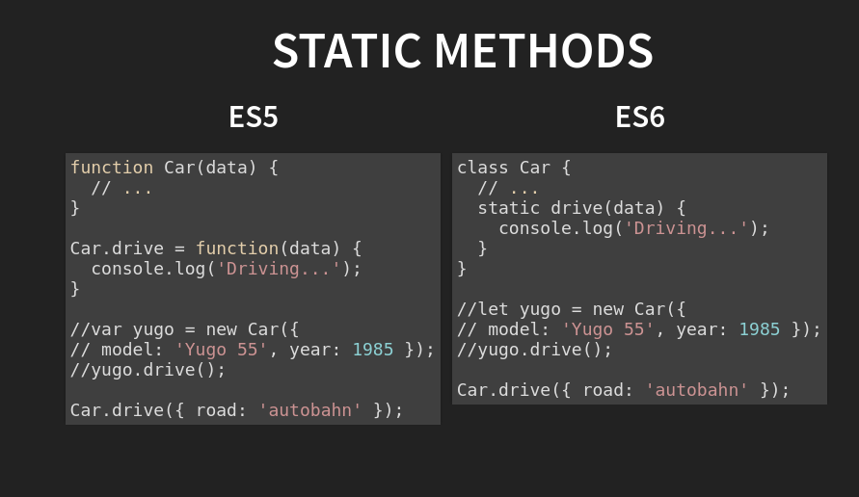

Slide 23
Modules
Language-level support for modules for component definition. Codifies patterns from popular JavaScript module loaders (AMD, CommonJS). Runtime behaviour defined by a host-defined default loader. Implicitly async model – no code executes until requested modules are available and processed.

Slide 24
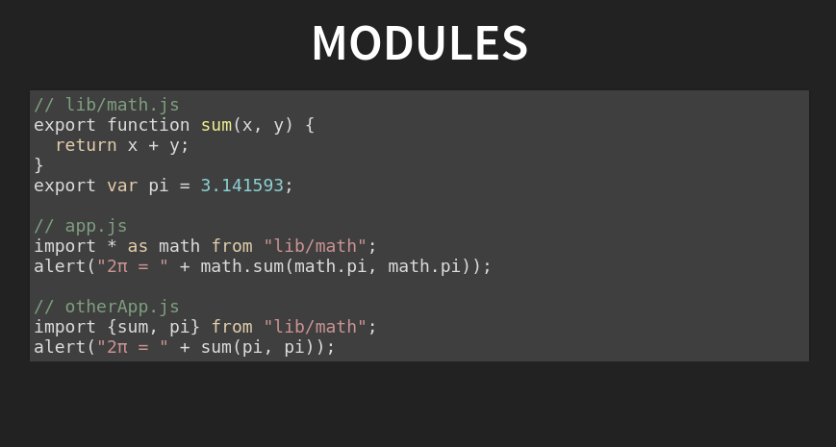
Modules

Slide 25
Arrow Functions
Anonymous can be denoted with => to make the code neater
Arrow functions can be useful to maintain scopes

Slide 26
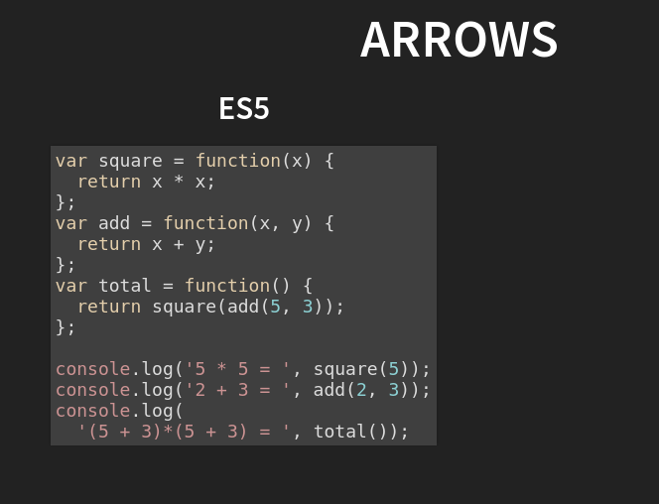

Slide 27
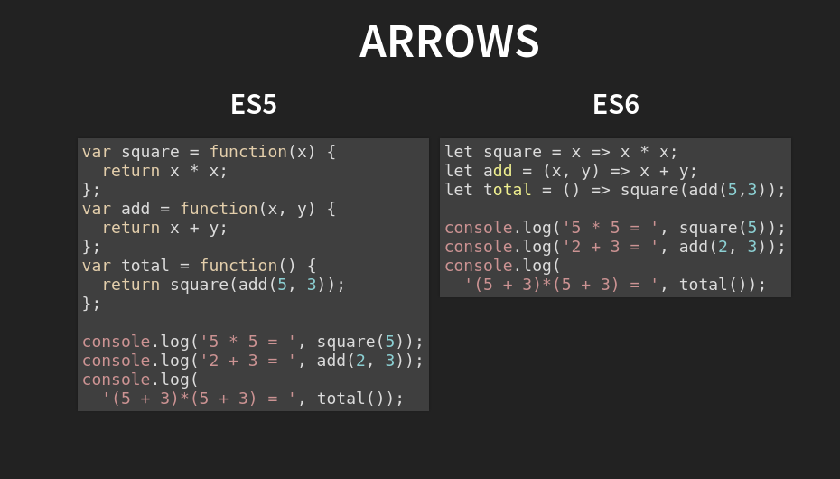

Slide 28
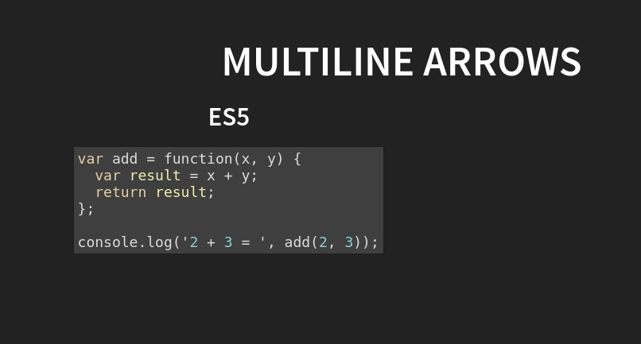

Slide 29
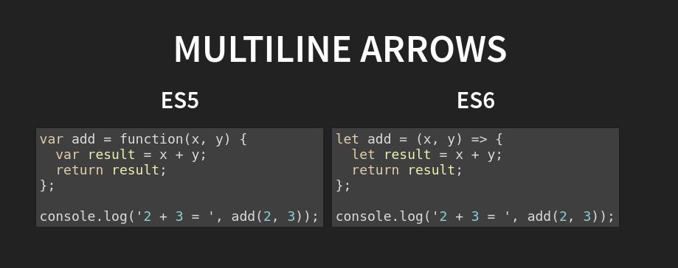

Slide 30
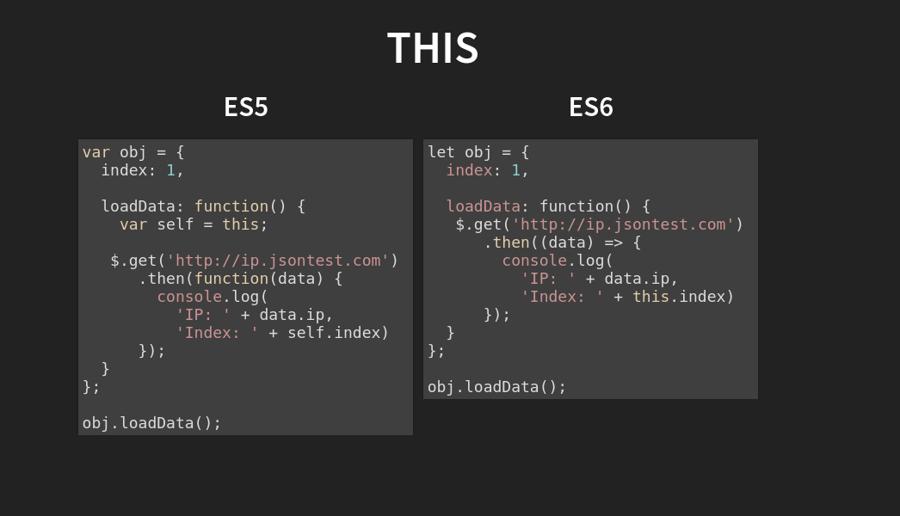

Slide 31
Let,Const,Var
With ES6, we went from declaring variables with var to use let/const.
The issue with var is the variable leaks into other code block such as for loops or if blocks.

Slide 32
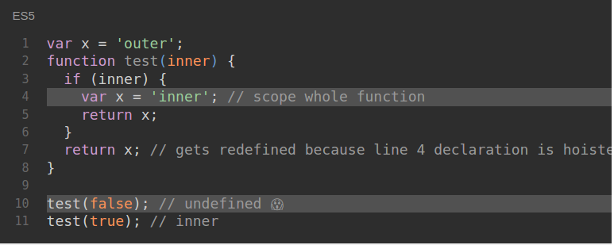

Slide 33
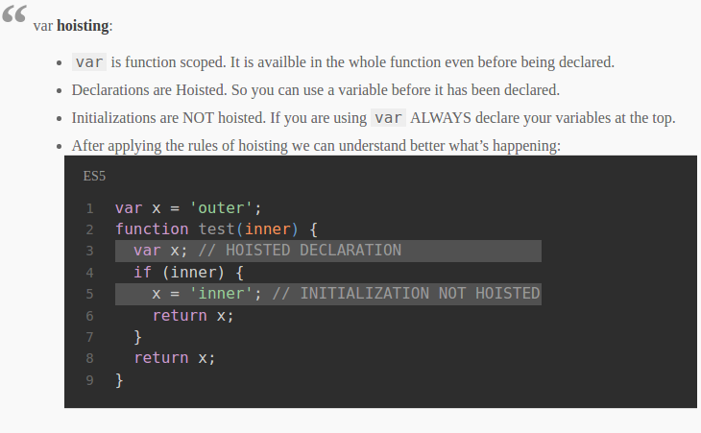

Slide 34
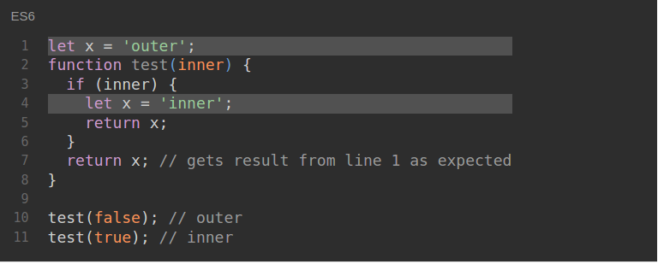

Slide 35
function test() {
const PI = 3.141569;
// PI = 6; -> ERROR
console.log(PI);
}

Slide 36
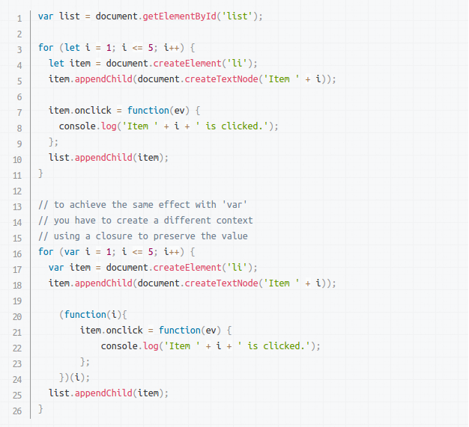

Slide 37
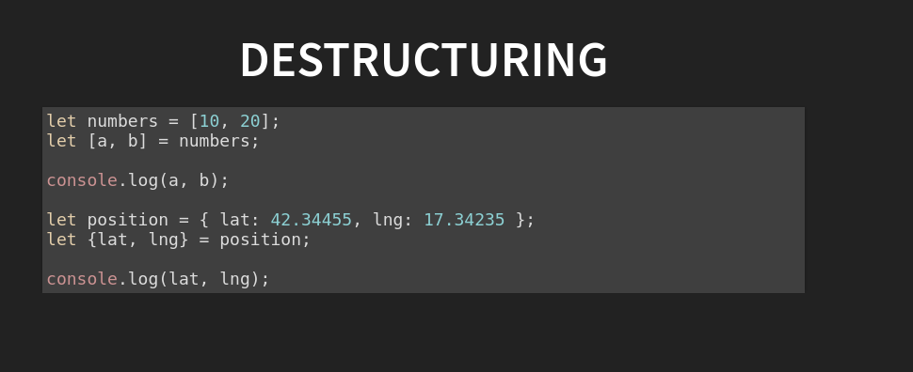
Object and Array Destructuring
ES6 desctructing is very useful and consise. Follow this examples:

Slide 38
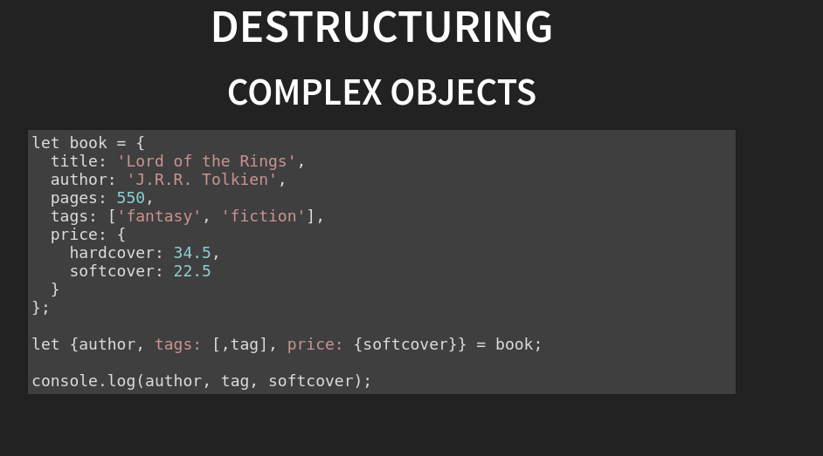

Slide 39
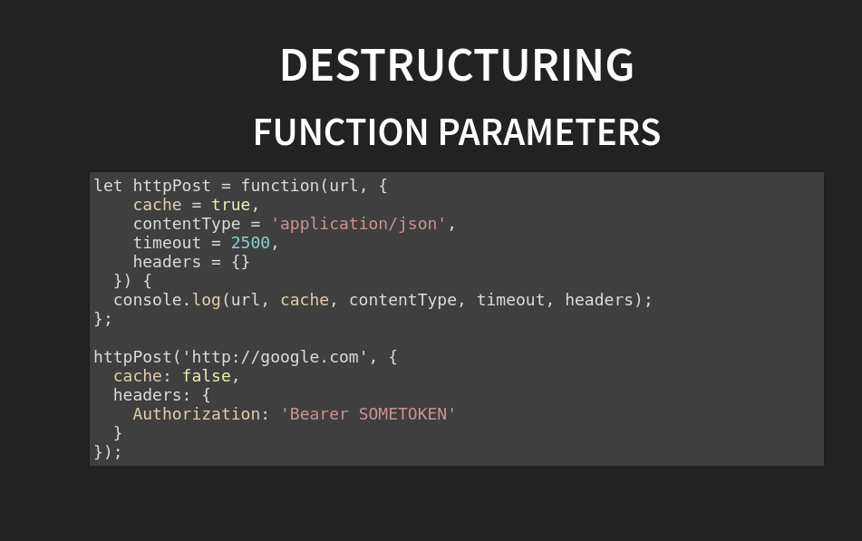

Slide 40
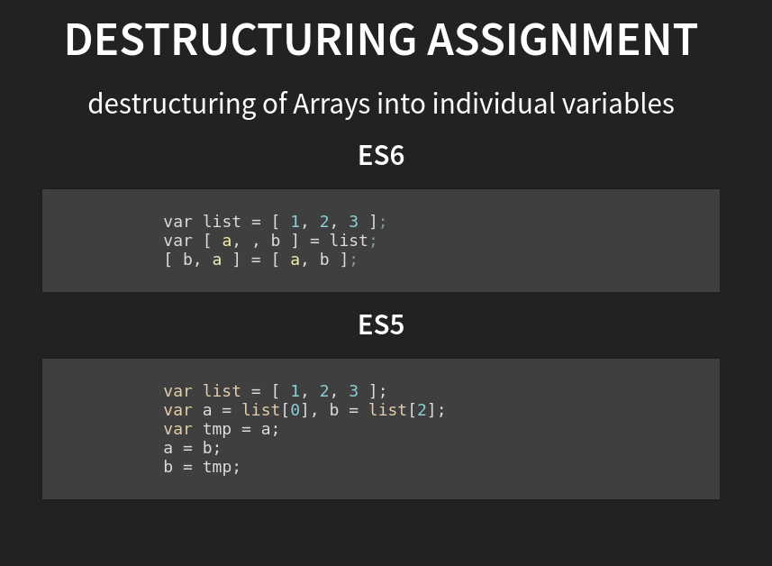

Slide 41
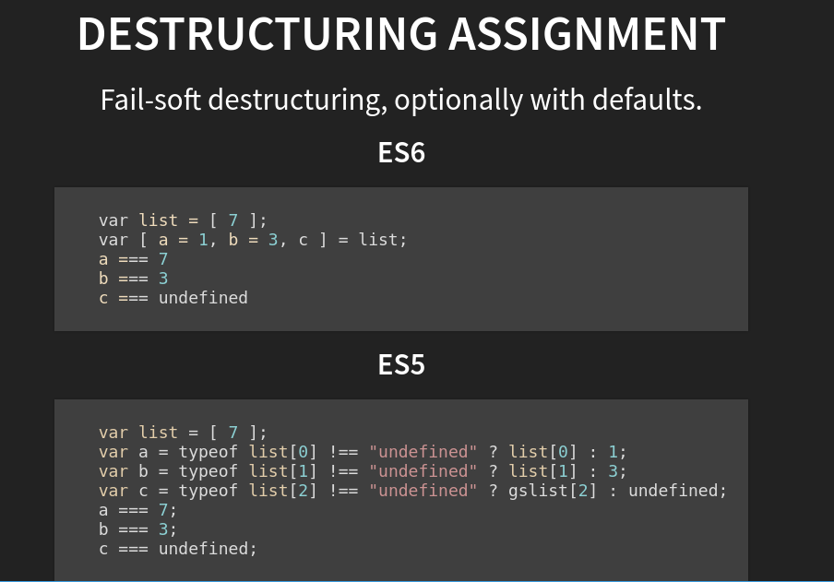

Slide 42
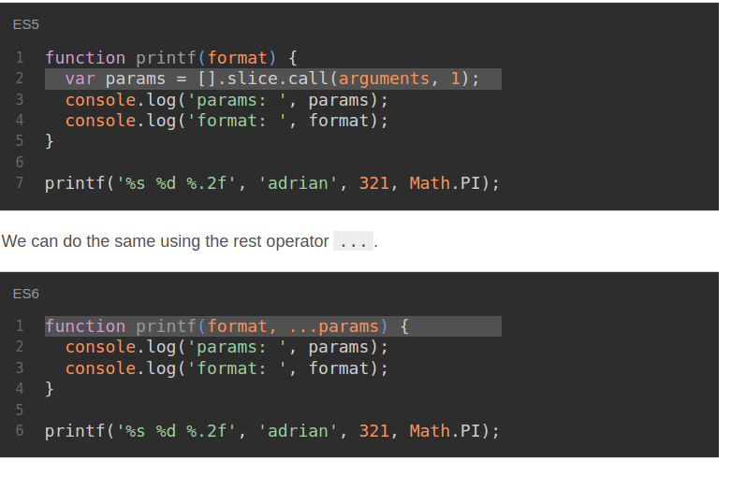
Rest Paramters
Provide Arguments Efficiently and neatly

Slide 43
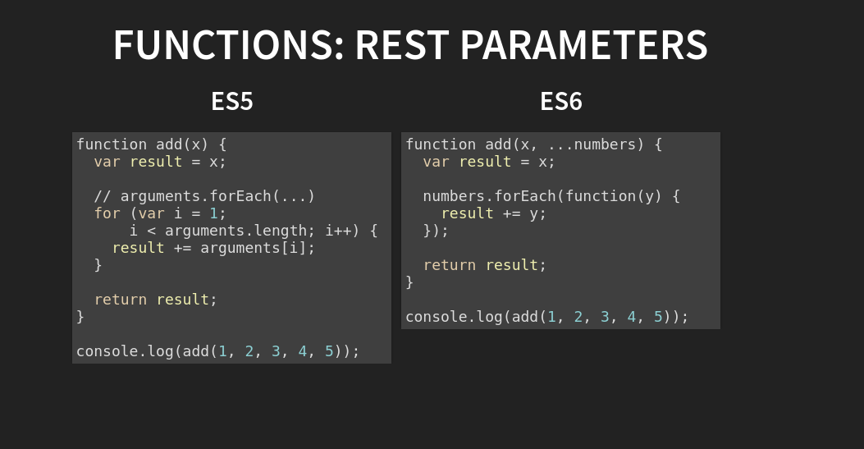
Rest Parameters

Slide 44
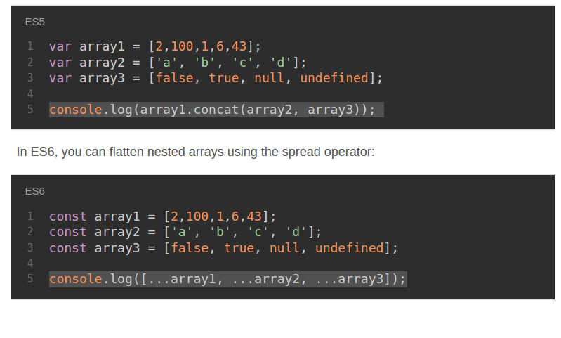
Spread Operator ...
Spread operator changed the way coding was done traditionally in Javascript, Can be Applied only on iterables

Slide 45
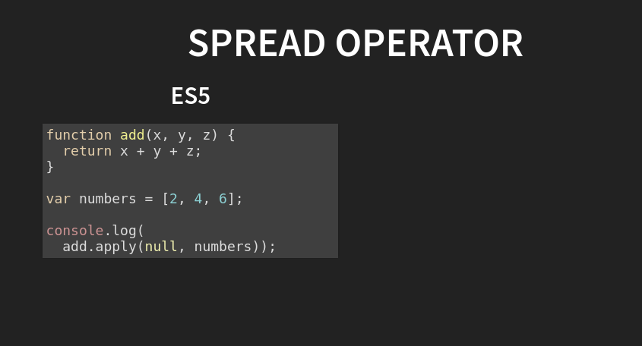
Spread Operator

Slide 46
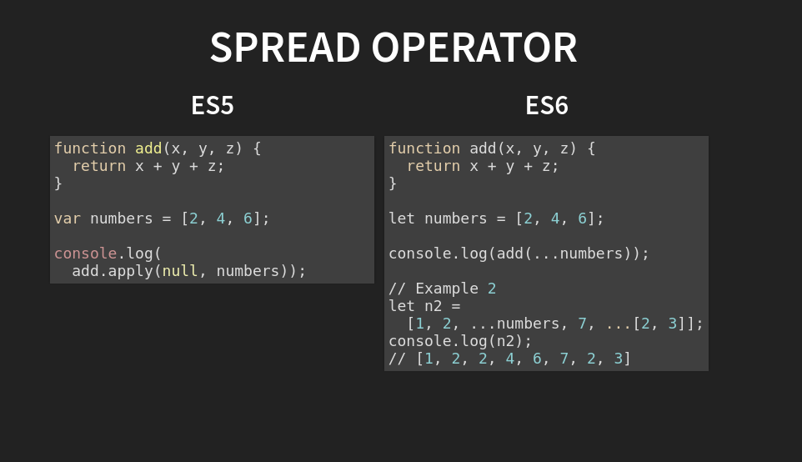
Spread Operator

Slide 47
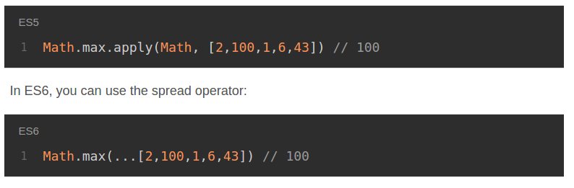
Spread Operator

Slide 48
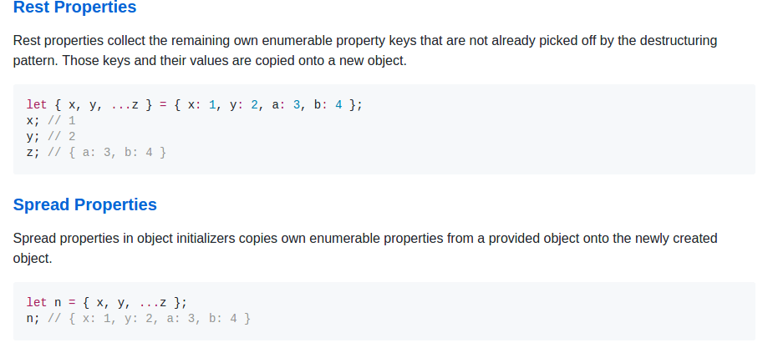
Spread Operator
Spread Operator on non iterables like object is underproposal

Slide 49
Literals
Template Literals (Interpolation)
Object Literals
Unicode Literals
Binary and Octal Literals

Slide 50
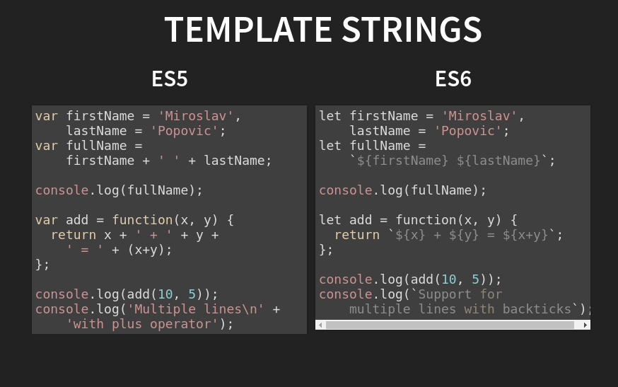
Template Literals

Slide 51
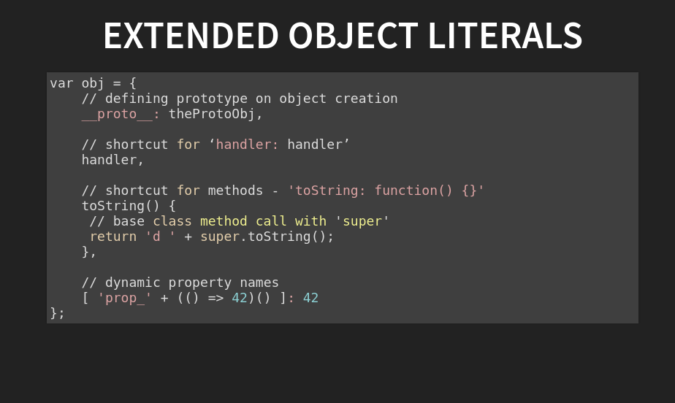
Object Literals

Slide 52
Symbols
A new primitive type of course! The seventh type of value in JavaScript to be exact. They are similar to Symbols in Ruby, but are not the same exact thing.
var computerName = Symbol('awesome desktop');

Slide 53
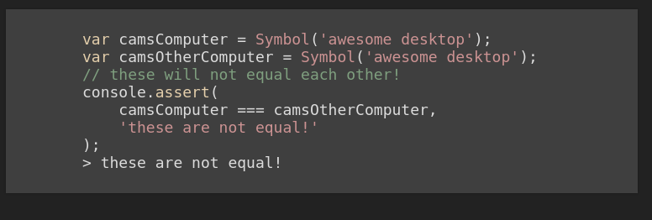
Symbols
Can be used for UUID’s

Slide 54
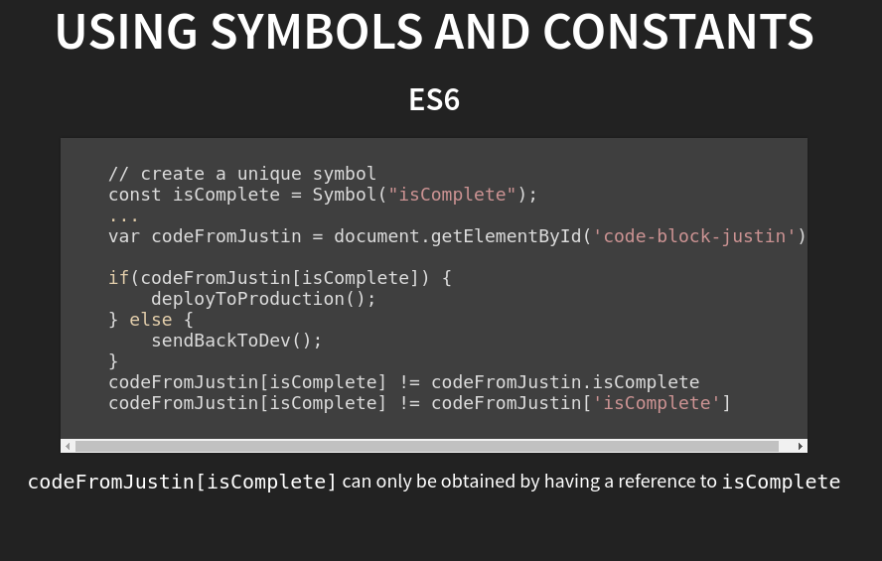
Symbols

Slide 55
Maps,Sets
ES6 introduces two new data structures: Maps and Sets

Slide 56
Maps,Sets
ES6 introduces two new data structures: Maps and Sets
Maps − enables mapping a key to a value.

Slide 57
Maps,Sets
ES6 introduces two new data structures: Maps and Sets
Maps − enables mapping a key to a value.
Sets − Sets are similar to arrays. However, sets do not encourage duplicates.

Slide 58
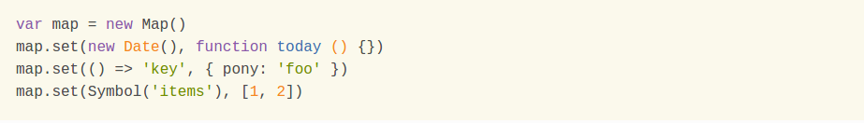
Maps
The Map object is a simple key/value pair. What makes it different from Object is Keys and values in a map may be primitive or objects.

Slide 59
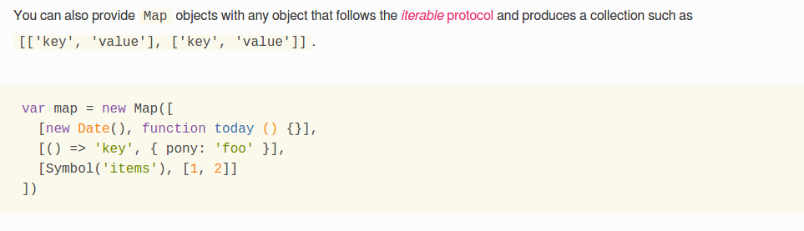
Maps

Slide 60
Sets
Set is similar to an array with an exception that it cannot contain duplicates. In other words, it lets you store unique values. Sets support both primitive values and object references.

Slide 61
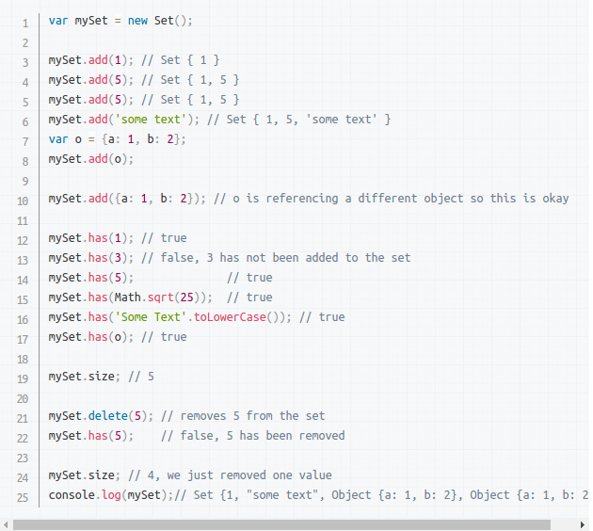
Sets

Slide 62
For more details of Maps and sets refer
http://2ality.com/2015/01/es6-maps-sets.html
MDN References of Maps and sets
https://ponyfoo.com/articles/es6-maps-in-depth

Slide 63
Weak Maps and Weak Sets
Both Weak Maps and Weak Sets are used for Garbage Collections
For more details refer
https://ponyfoo.com/articles/es6-weakmaps-sets-and-weaksets-in-depth

